Slide 1
Markov Model -2 Time-dependence in trace treatment effect
2023年10月24日

Slide 2
Agenda
Quick review of simple Markov model and survival functions
Heemod workshop: simple Markov model
Video review and preview
Lecture and discussion: time-dependency in Markov model

Slide 3
1. Quick review of simple Markov model and survival functions

Slide 4
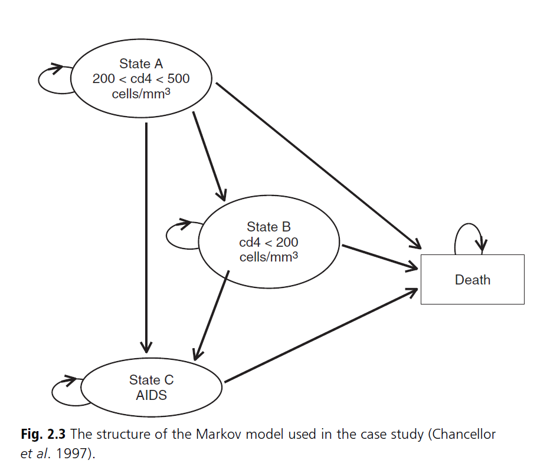
HIV case study-1 Disease model

Slide 5
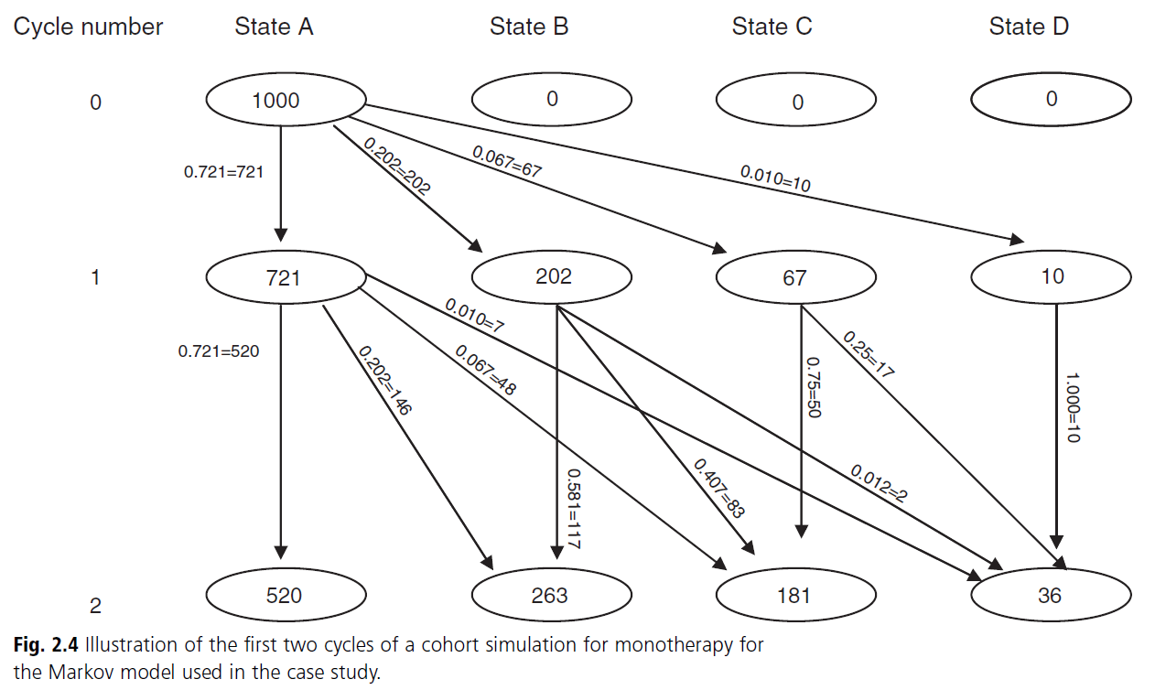
HIV case study-2 Markov trace

Slide 6
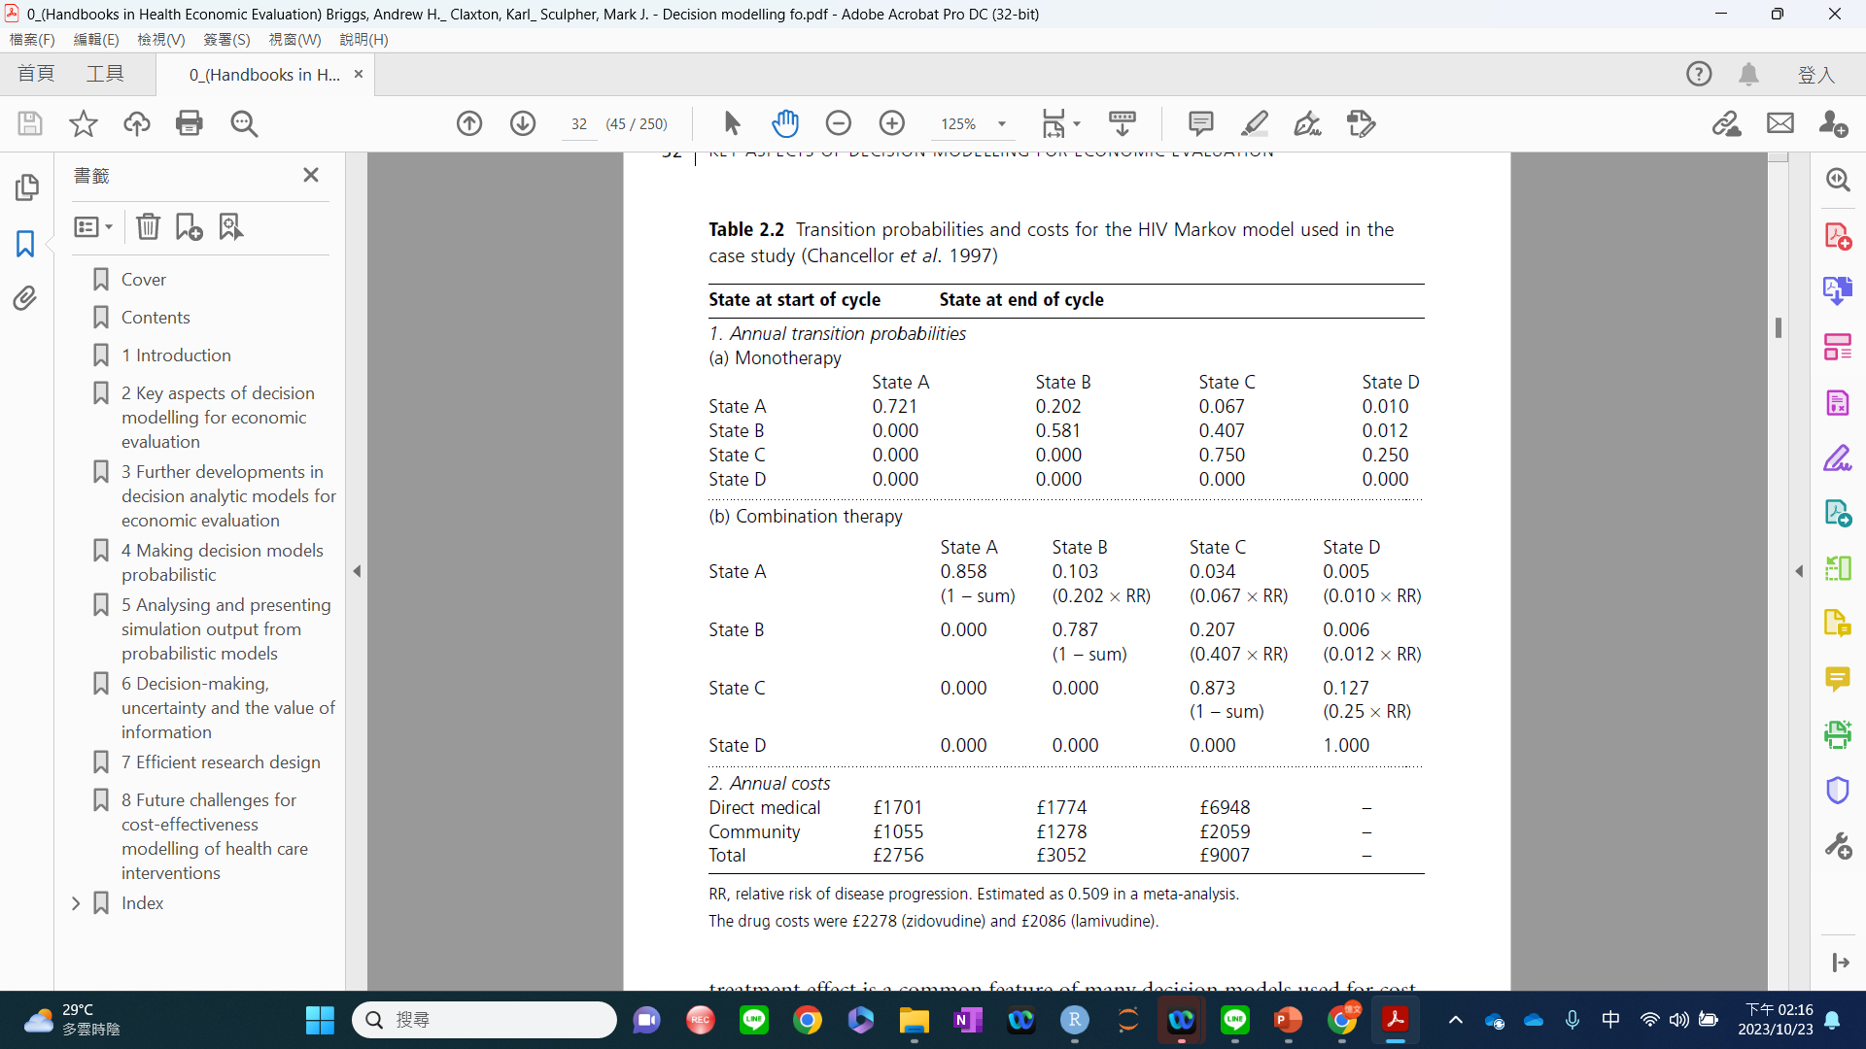
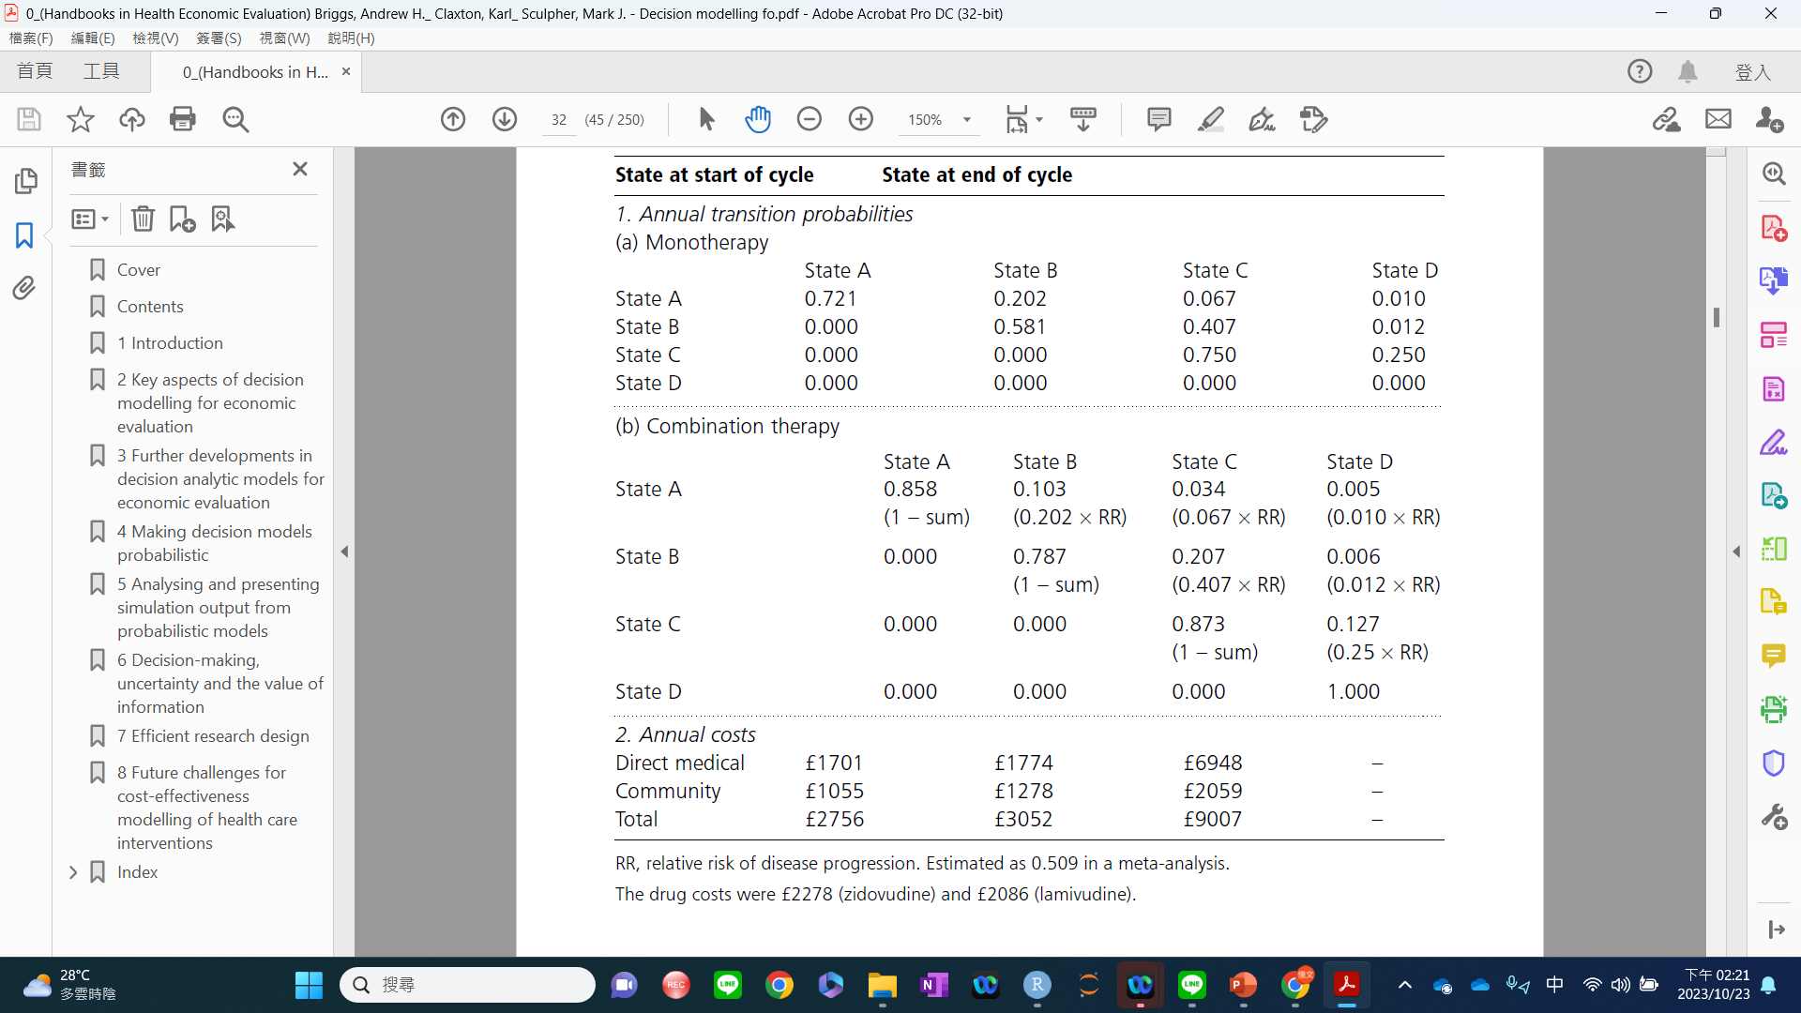
HIV case study-3 outcome parameters (cost)

Slide 7
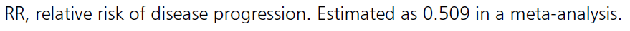
HIV case study-4 model parameters
Time-dependence
Treatment effect

Slide 8
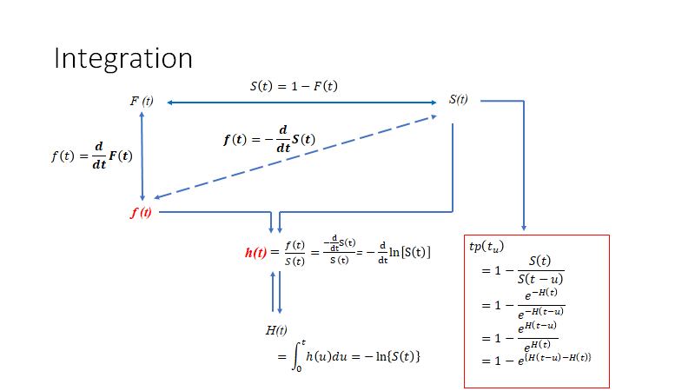

$$S\left(t\right)=e^{−H\left(t\right)}$$

Slide 9
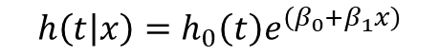
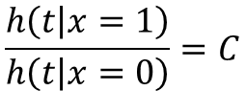
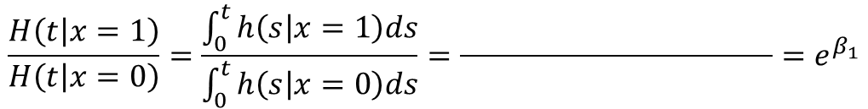
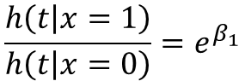
Proportional hazard assumption
$$\frac{h\left(t | x=1\right)}{h\left(t | x=0\right)}=C$$
$$h\left(t | x\right)=h_{0}\left(t\right)e^{\left(β_{0}+β_{1}x\right)}$$
hazard function of a constant?
$$\frac{h\left(t | x=1\right)}{h\left(t | x=0\right)}=e^{β_{1}}$$
hazard ratio
$$\frac{H\left(t | x=1\right)}{H\left(t | x=0\right)}=\frac{\int_{0}^{t}{h\left(s | x=1\right)ds}}{\int_{0}^{t}{h\left(s | x=0\right)ds}}=\frac{ }{ }{=e}^{β_{1}}$$

Slide 10
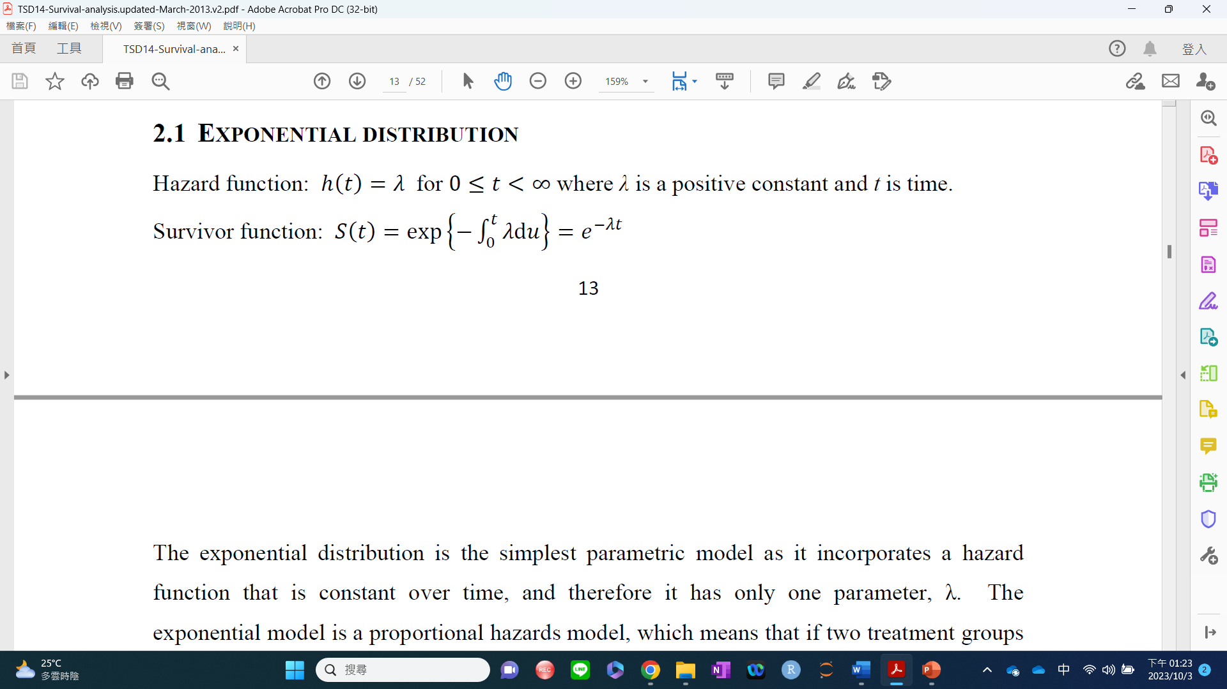
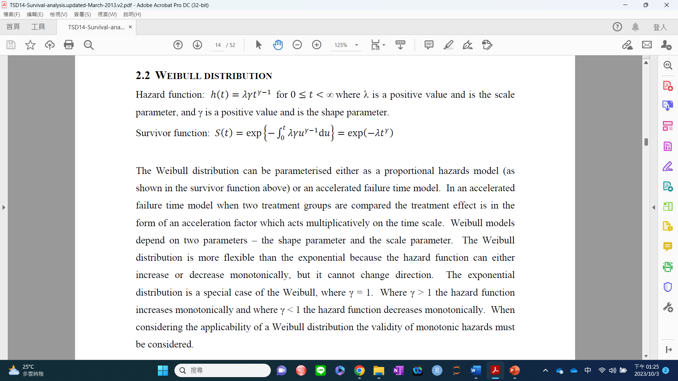
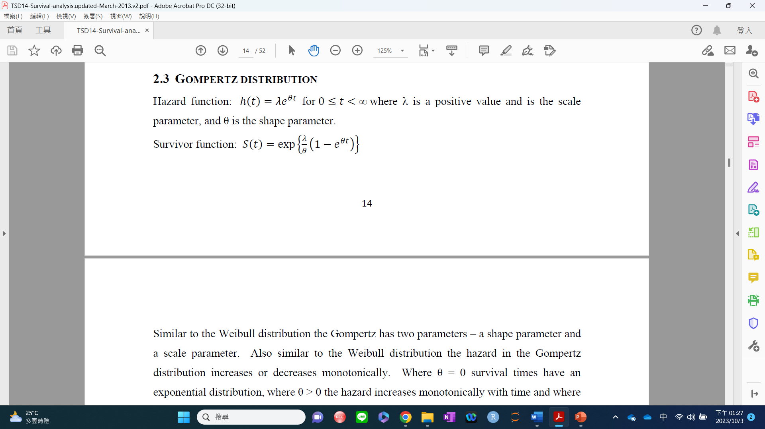

Slide 11
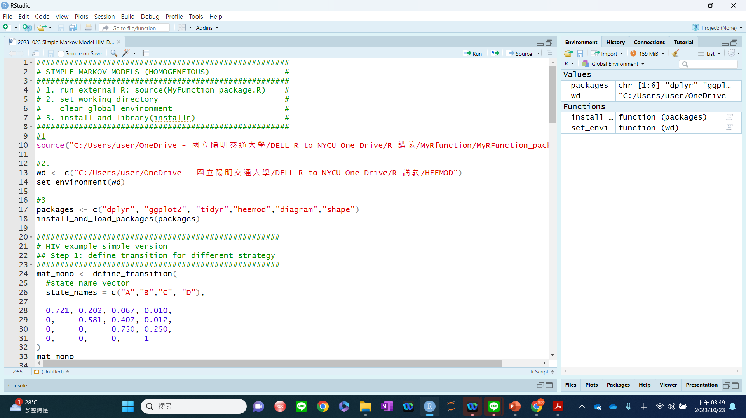
2. Heemod workshop: simple Markov model

Slide 12
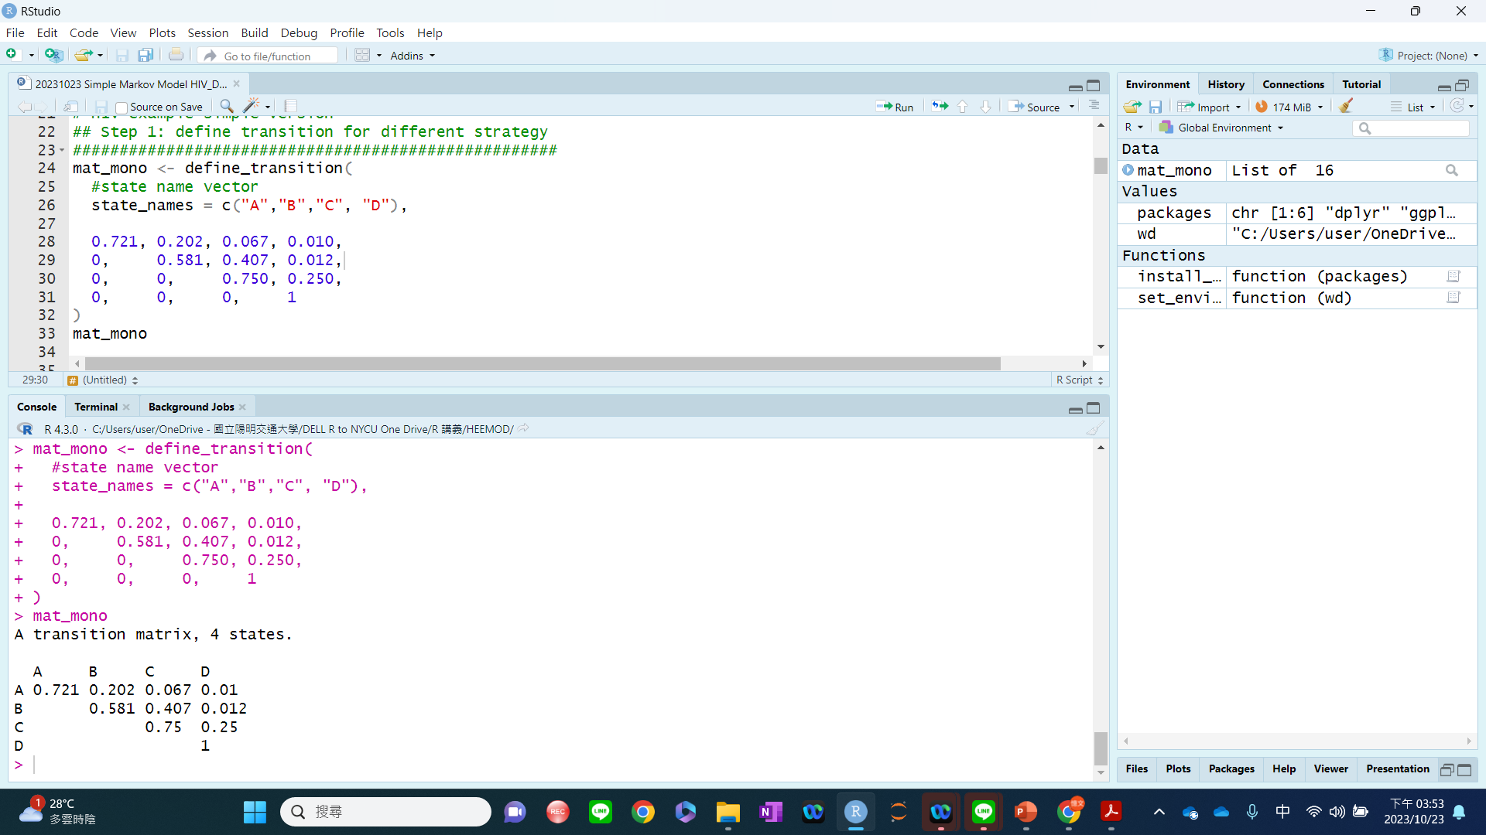

Slide 13
3. Video review and preview

Slide 14
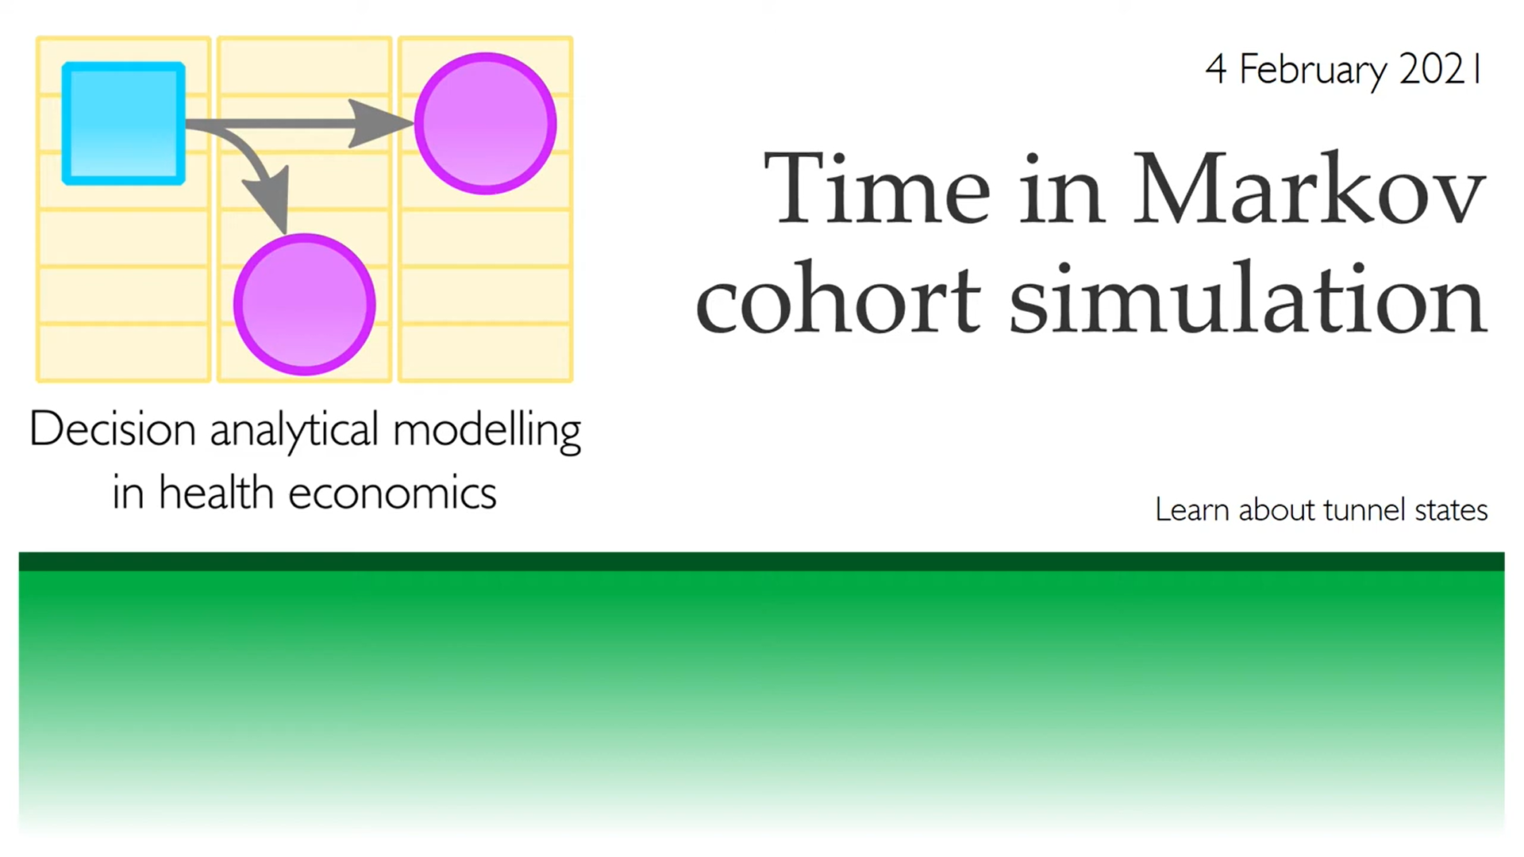
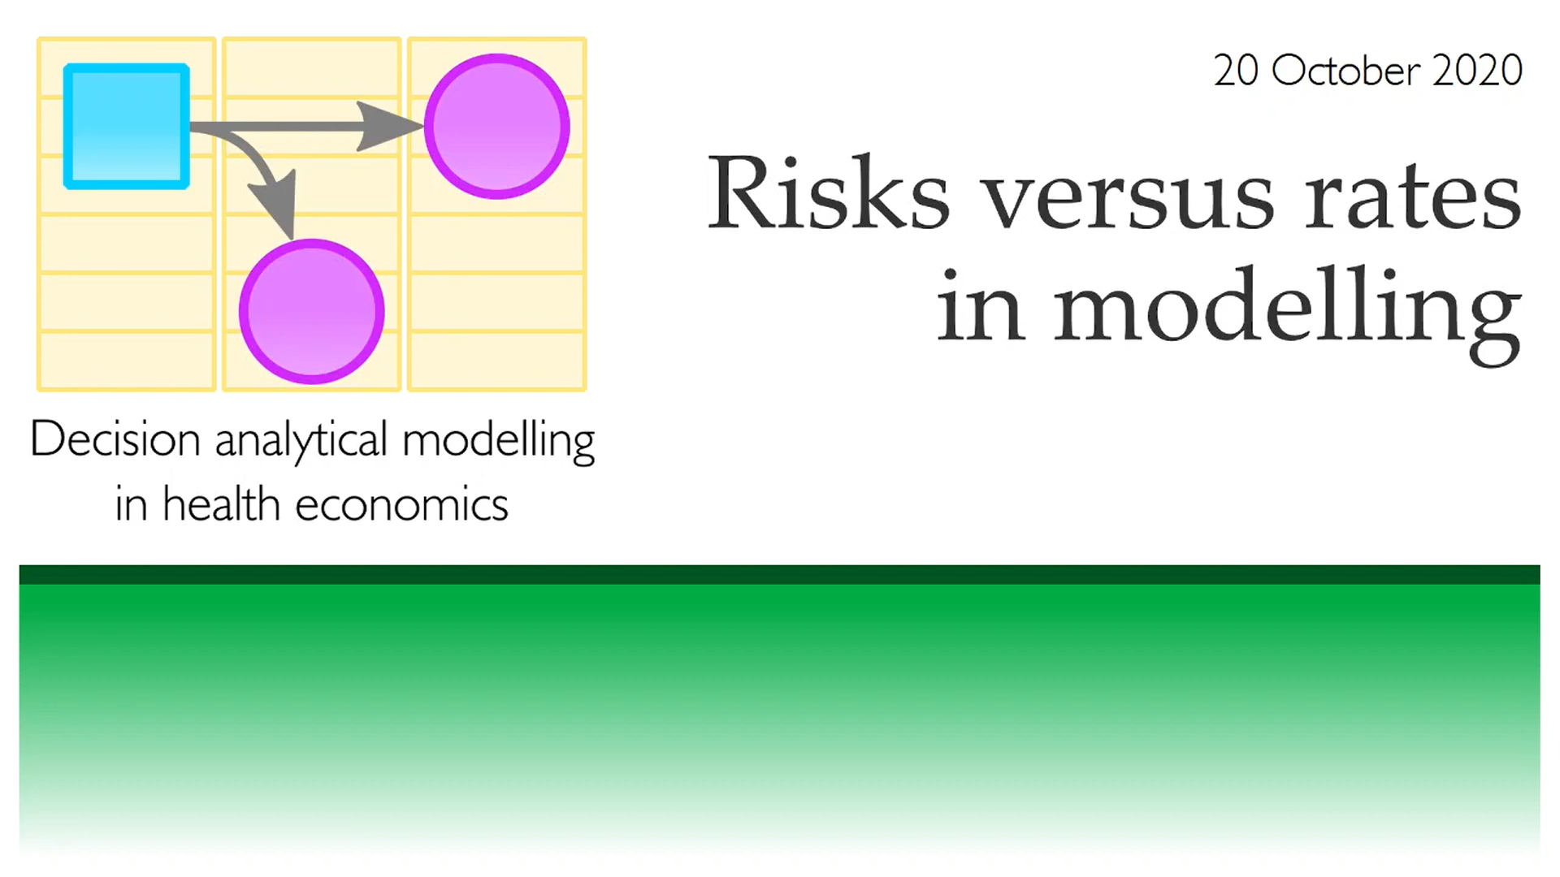
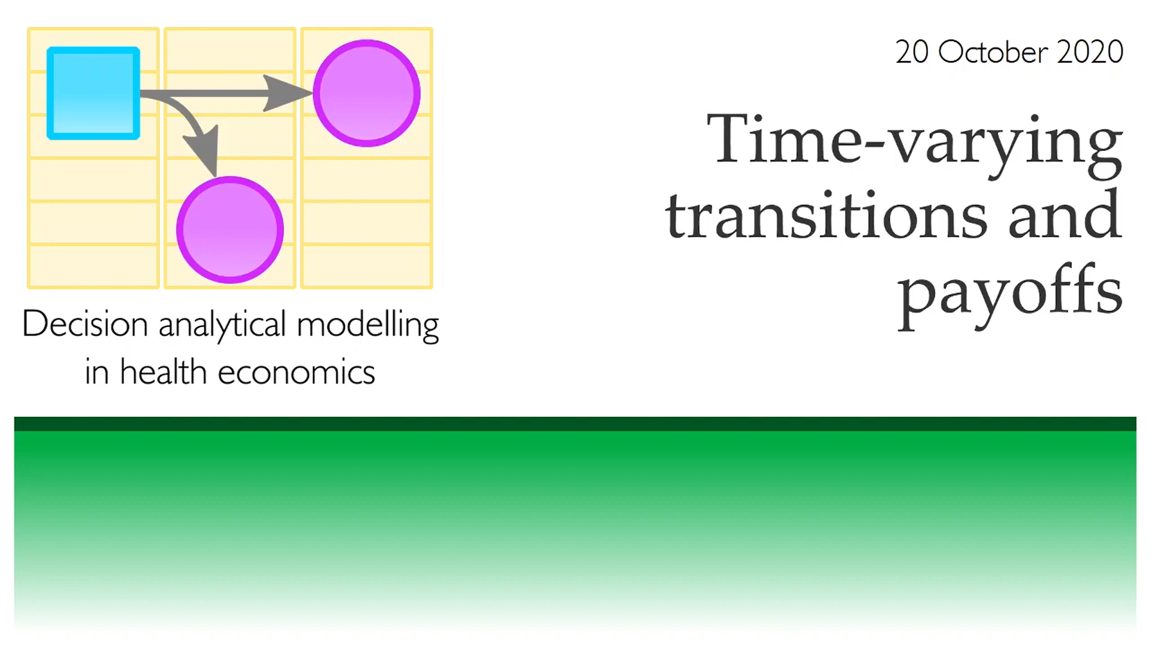
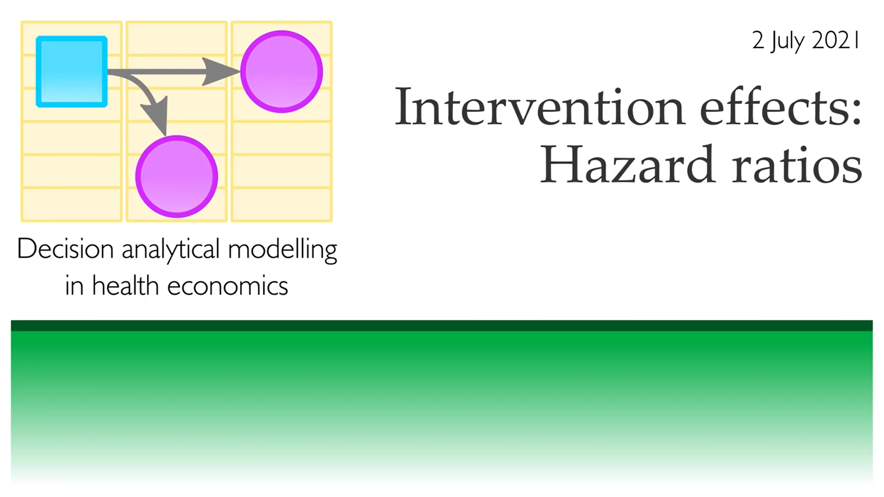
https://www.youtube.com/watch?v=U81LW7czsf4
https://www.youtube.com/watch?v=787gUuPUn3Q
https://www.youtube.com/watch?v=ATey9Z4R8oI
https://www.youtube.com/watch?v=uBQ1Ow-6O2Y

Slide 15
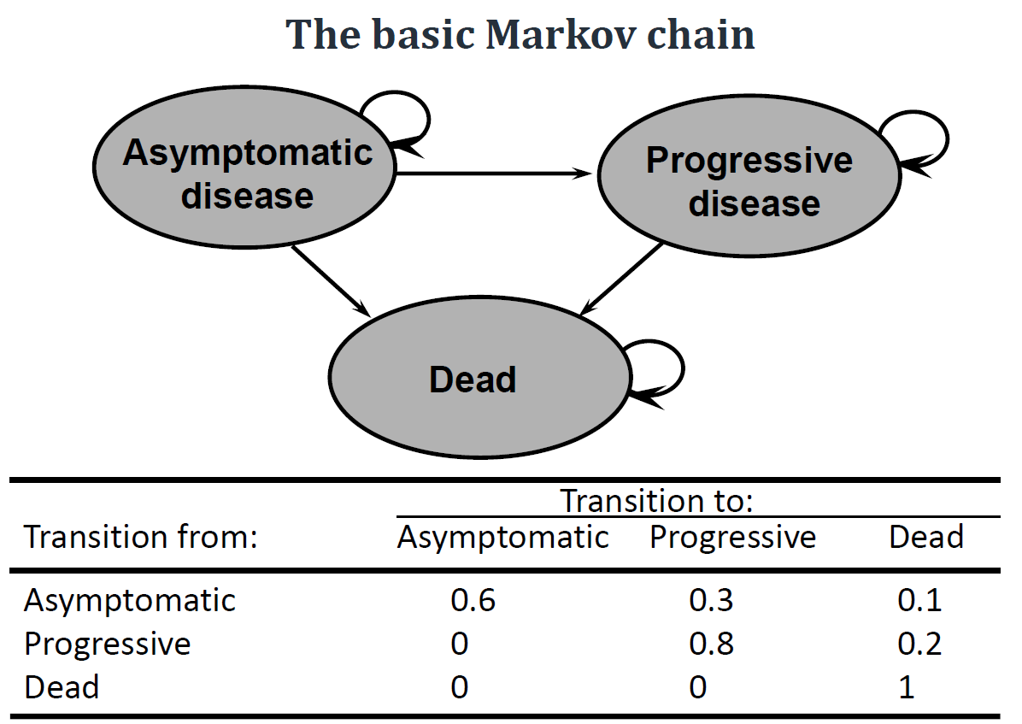
4. Lecture and Discussion
Rate and risk (probability)
Time-varying transition probability

Slide 16
Distinction between rates and probabilities
Brigg page 51 Box 3.1

Slide 17
Transition probability-1: survival and hazard

Slide 18
$$S\left(t\right)=e^{−H\left(t\right)}$$

Slide 19
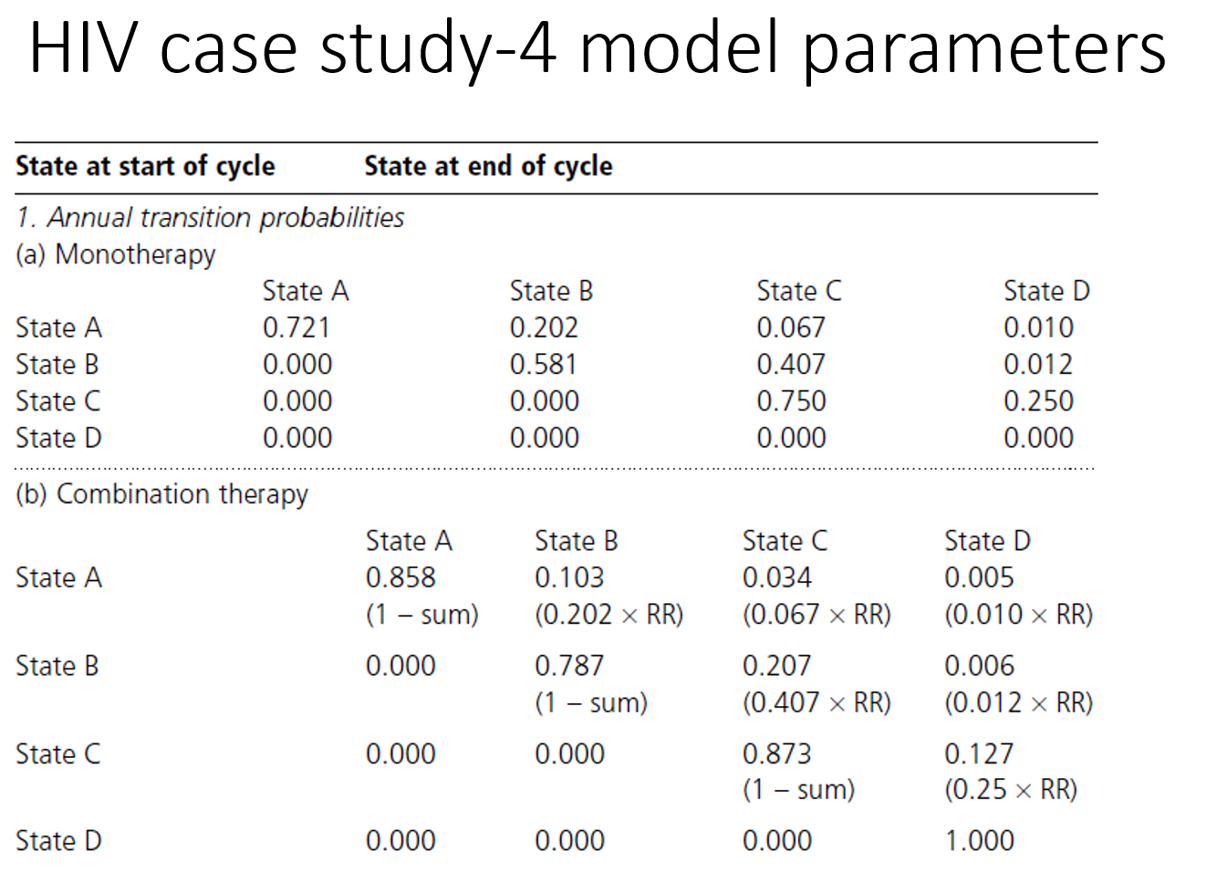
Transition probability-2: treatment effect
How to modify transitional probability function with a constant relative risk or a constant hazard ratio?
HR?

Slide 20
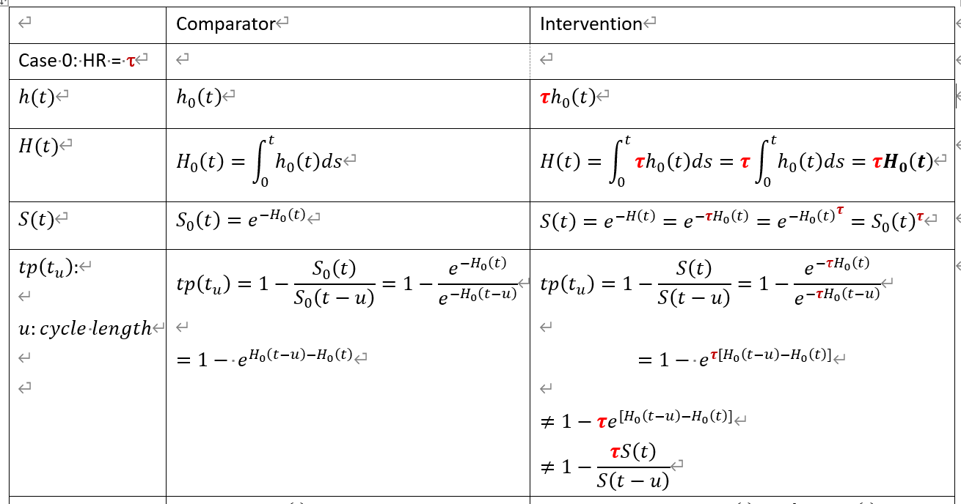
Transition probability-3: Summary

Slide 21
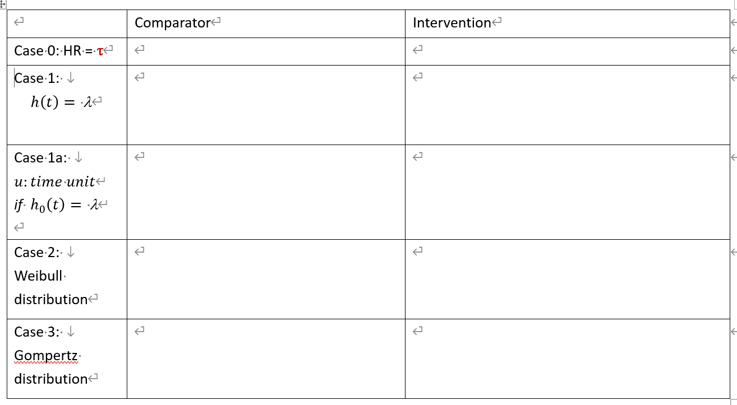
Transition probability-3: Summary (Edlin, p.97-100)

Slide 22
Question
Intervention vs. comparator: S_{I}(t) = 0.8 S_{c}(t) in 10 years

Slide 23
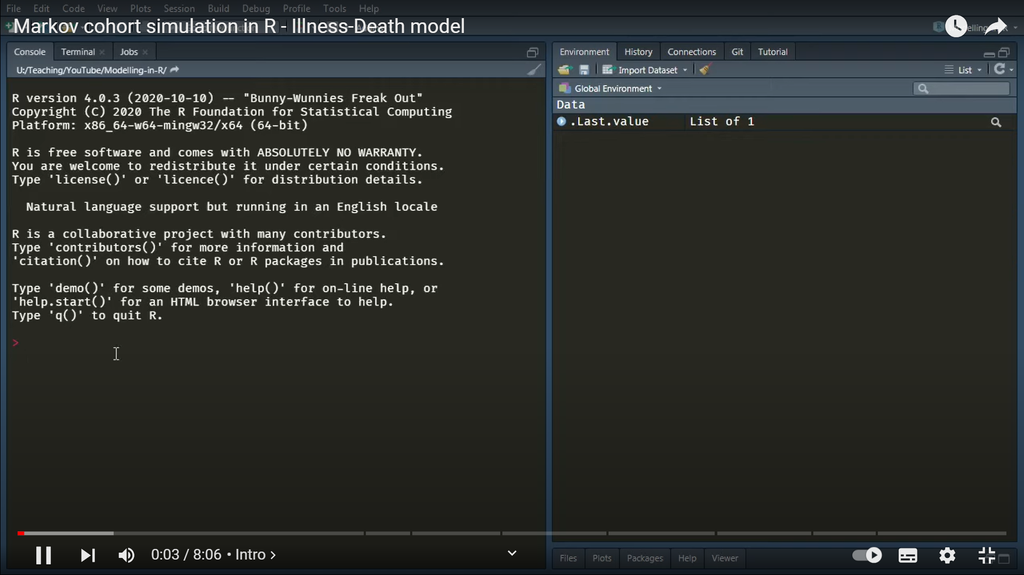
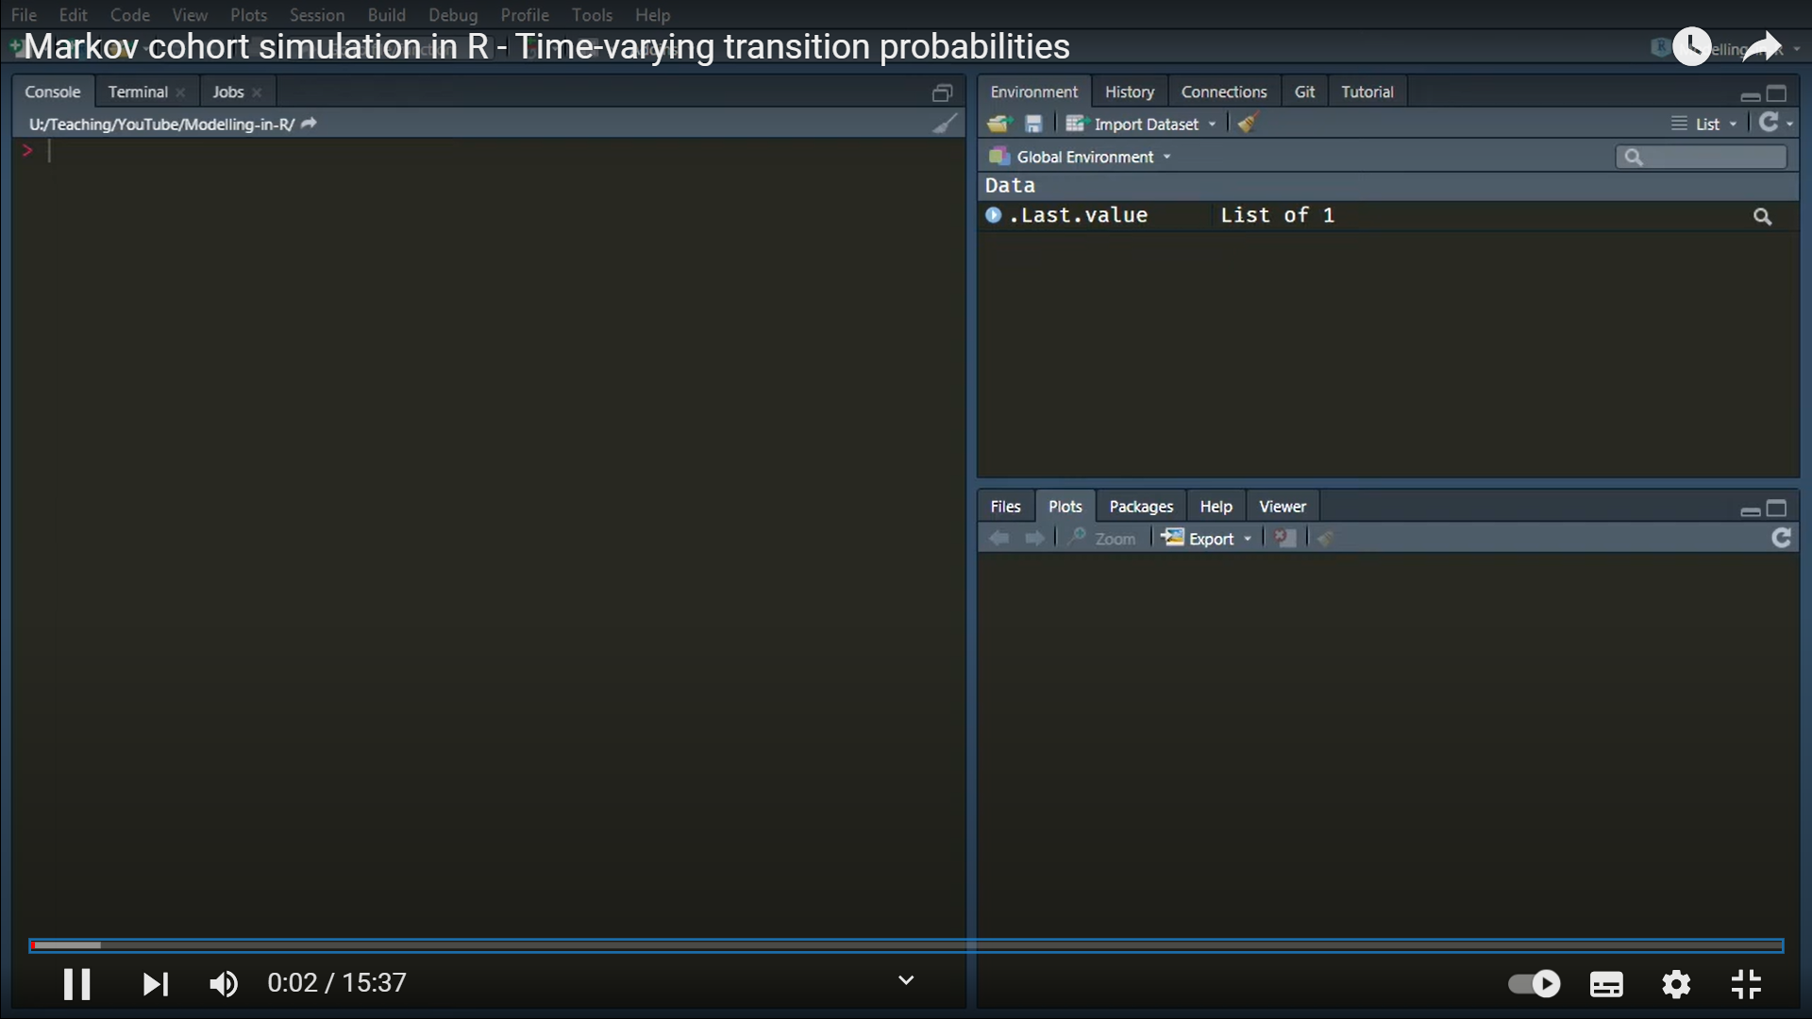
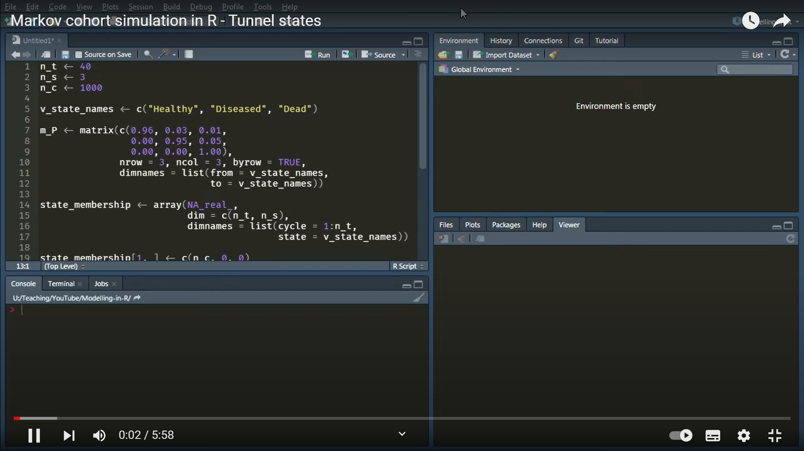
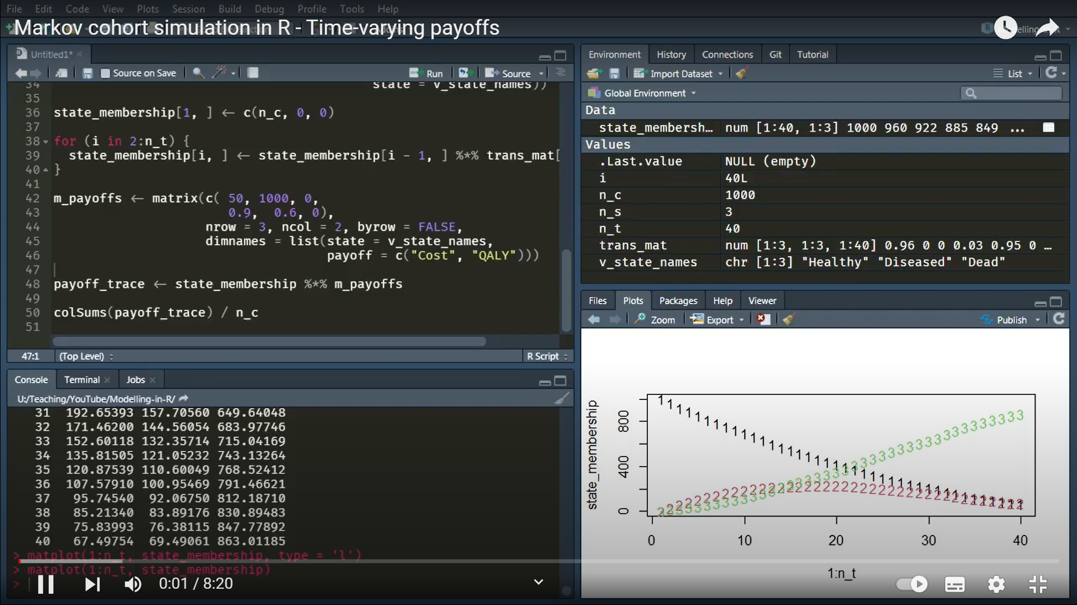
Brief intro
https://www.youtube.com/watch?v=xxtGOKLdQR0
Time-varying transition probability
https://www.youtube.com/watch?v=s4ZeRL-HeSs
Tunnel states
https://www.youtube.com/watch?v=-m9xm1KY9Og
Time-varying payoffs
https://www.youtube.com/watch?v=9BXCl3Iwf4M

